Slide 1

Implementation and Analysis of Parallel Graph Algorithms
Research: A Parallel Algorithm Template for Updating Single-Source Shortest Paths in Large-Scale Dynamic Networks
Parallel Distributed Computing
Muaz Ahmed
Ayan Asif
Muhammad Abbas

Slide 2
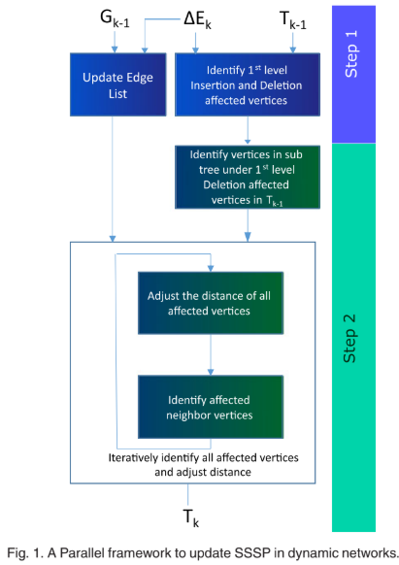
Motivation & Problem Overview
SSSP in Dynamic Networks
Traditional algorithms assume static graphs
Real-world networks change over time (edge insertions/deletions)
Challenges
Efficiently updating SSSP without full recomputation
Balancing load and avoiding synchronization overhead
Need for Parallelism
Exploit multiple cores and GPUs for faster processing

Slide 3
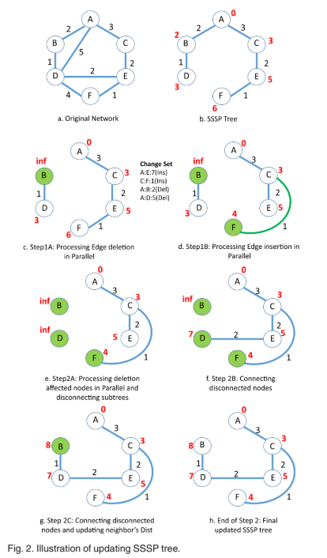
Parallel Algorithm Design & Key Contributions
Two-Step Framework:
Identify the affected vertices
Iteratively update the SSSP tree
Key Innovations:
Avoiding heavy locking by iterative updates
Using a rooted-tree data structure to maintain SSSP
Preventing cycle formations during concurrent updates

Slide 4

Implementation Strategy & Tools
Programming Models
Graph Partitioning
Version Control
MPI
OpenCL
OpenMP
METIS
GitHub

Slide 5
Scalability Analysis & Performance Evaluation
Algorithm Complexity:
Expect O(m/p) time complexity
Expect O(D·(x·d)/p)
Evaluation Plans:
Targeting significant speedup, particularly on GPU architectures
Will explore the performance differential in edge insertion-heavy vs deletion-heavy scenarios
Scalability Focus Areas:
Investigate how edge change ratios affect performance
Integrate load balancing and dynamic scheduling strategies

Slide 6
Conclusion: Plans for Execution
Phase 1
Phase 2
Phase 3
Planning
Framework Architecture
Implementation & Testing
Define problem space
Identify use cases
Select benchmark datasets
Set evaluation goals
Partition graph (METIS)
Design parallel model
Combine MPI + OpenMP/OpenCL
Enable lock-free updates
Develop core algorithm
Run scalability tests
Vary update conditions
Benchmark against baselines

Slide 7
Thank You
Questions?

